Slide 1
Order Management Application
Made By- Yash Tandon

Slide 2
Abstract
The Order Management App is a LWC(Lightning Web Components) based solution for creating and handling orders on the salesforce platform.
The application allows the user to search for the products they want to buy based on the name, brand and price range of the products along with provision to specify quantity of the product and to book the order.
The User can check the status of the order in the detail page.

Slide 3
Types Of Users
Support Team
Sales User
Business User

Slide 4
Support Team
The Support Team Can-
Login to the application.
Create Sales users and Business users.
Assign roles to the created users.
View all the data on the application and can delete orders booked.
Can delete the orders.

Slide 5
Sales User
The Sales User can-
Login to the application.
Search for the products after selecting a valid account and valid starting date.
Specify the quantity of each product and discount as well.
Remove the selected products from the list before booking.
View the bookings of the orders made by them only.
Create invoices for the products and order as well.

Slide 6
Business User
The Business User can-
Login to the application.
View the accounts, related contacts , orders and invoices only.
Approve the orders booked by the sales user when the order amount is greater than 100000.

Slide 7
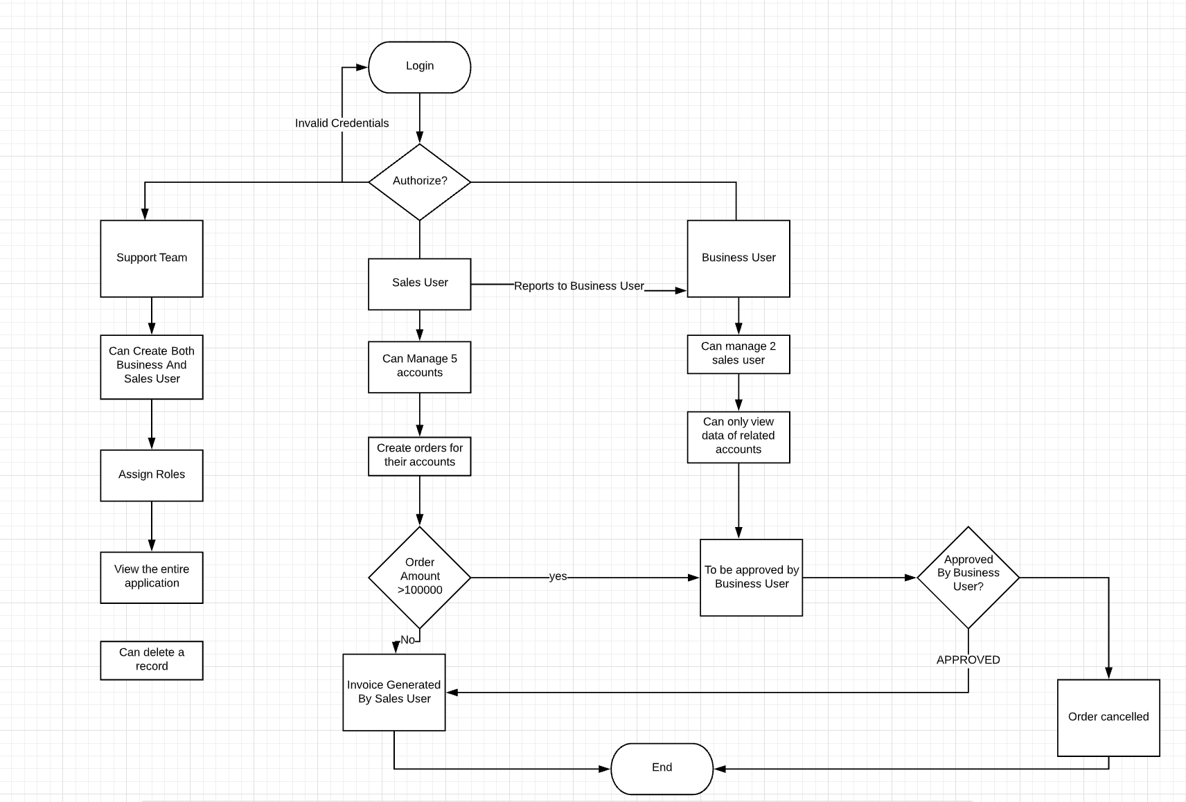
Flowchart Diagram

Slide 8
Wireframes

Slide 9
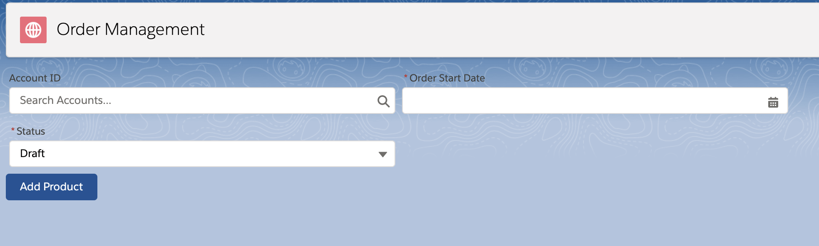
Order Creation Home page :

Slide 10
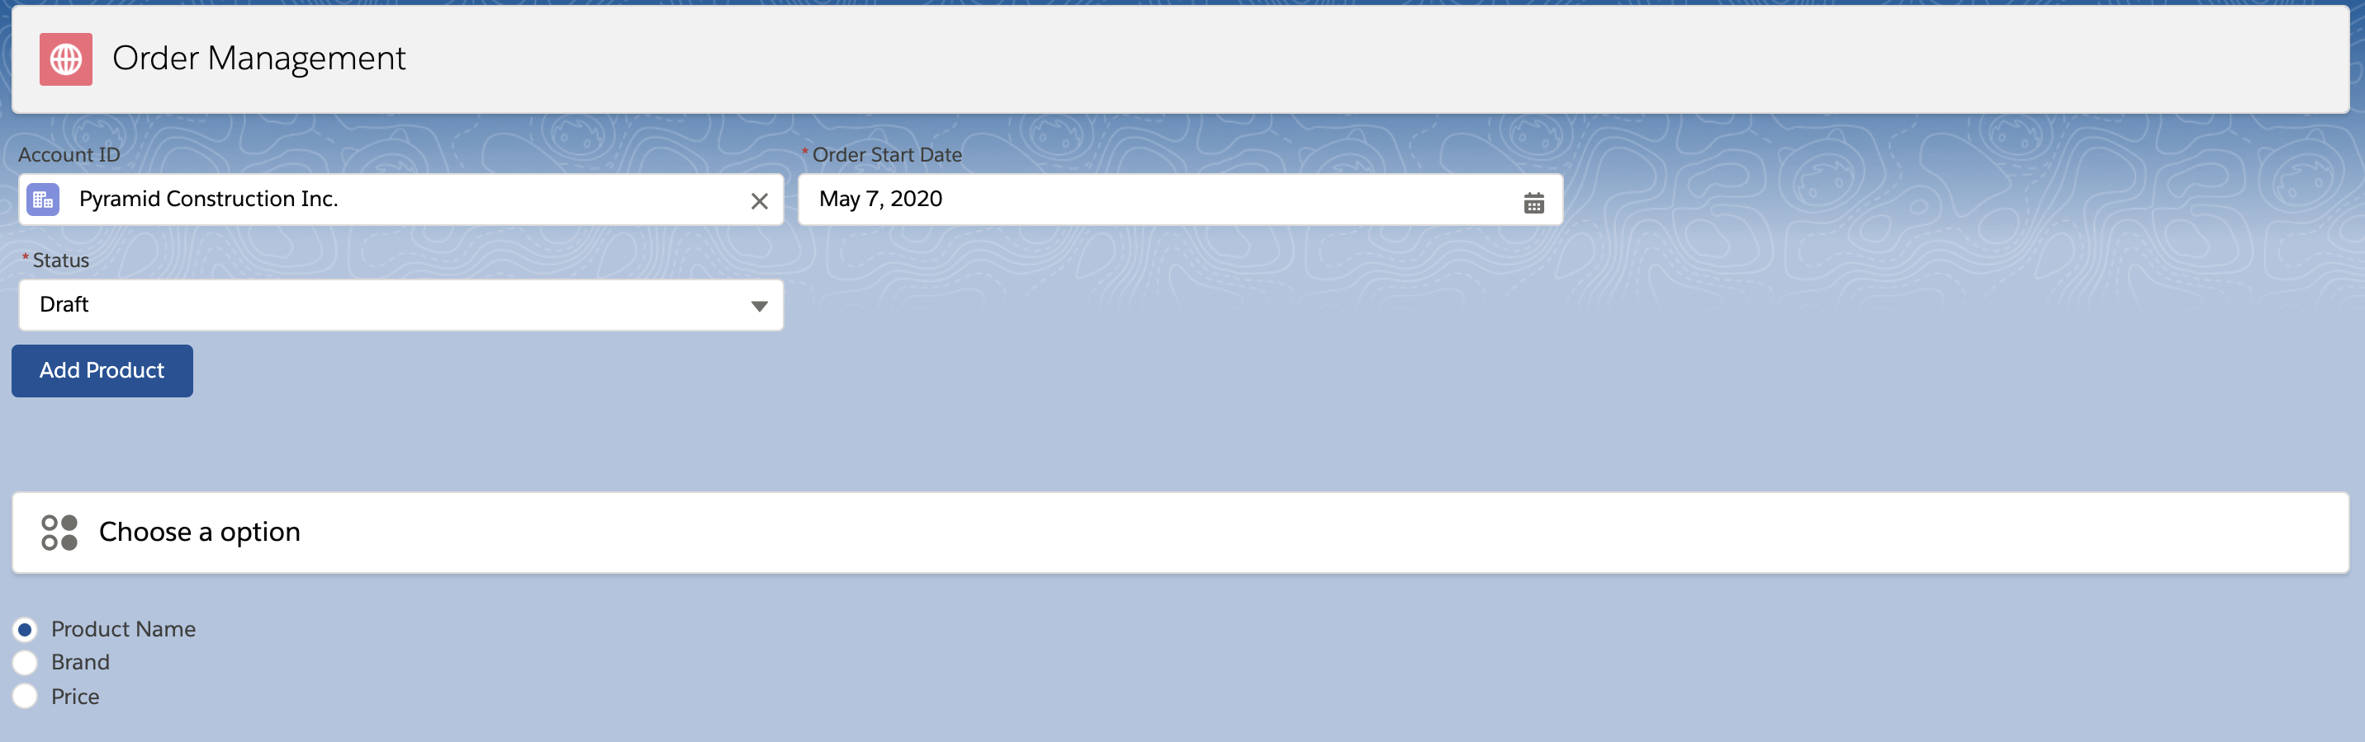
Order Search Filters

Slide 11
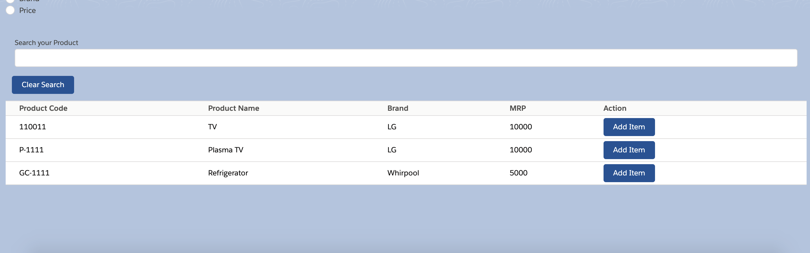
Product List

Slide 12
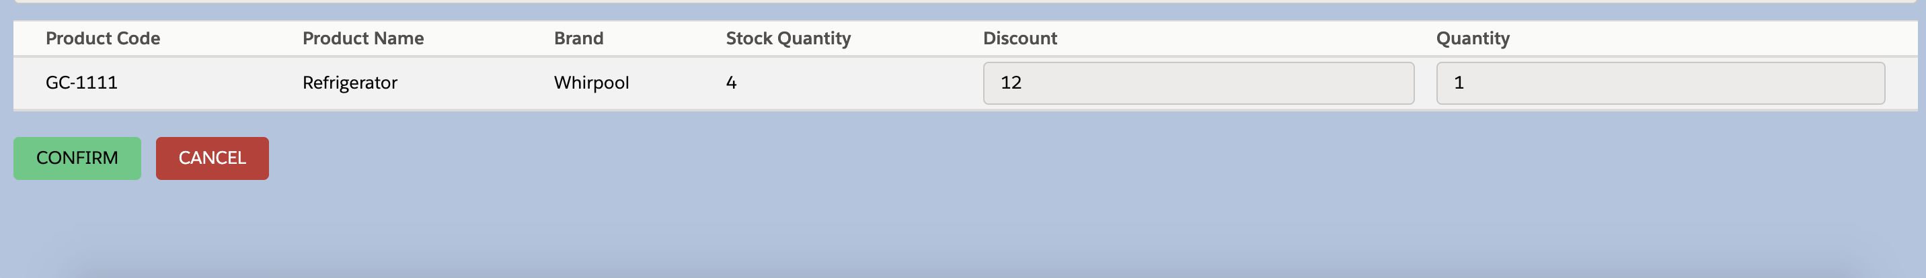
Order Summary

Slide 13
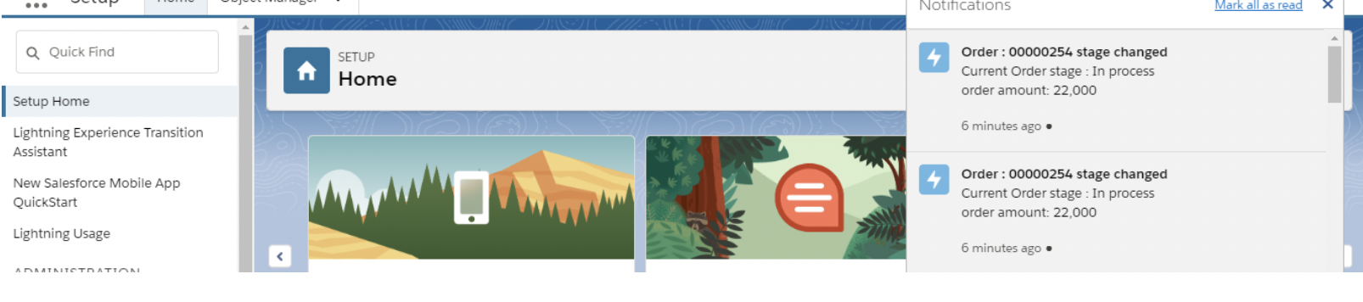
Order Change Notification

Slide 14
Validations & Assumptions
Sales user should enter quantity less than the stock quantity
Desired quantity cannot be negative
Discount should be in the range of 0-100%
Order creation date should be today’s date
After Creating order sales user cannot delete it. Only Support team member can.

Slide 15
THANK YOU!

